Slide 1


UN Funding Allocation Based On WHO Life Expectancy Data
February 22, 2024

Slide 2


AGENDA
Business Question
Exploratory Data Analysis (EDA)
Principal Component Analysis (PCA)
Regression Methods
Performance Discussion

Slide 3


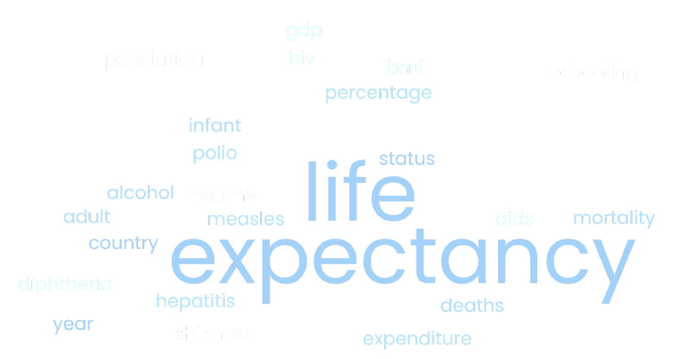
Business Question
How do various factors related to socioeconomic and health conditions impact countries' life expectancy and consequently determine the countries that are in most need of funding by the UN?
Our goal is to develop a Regression model that can predict the Life expectancy of a country based on several Physical, Social and Economical features that will be instrumental towards the decision regarding the amount of Financial Aid to be allocated for that country.
Life Expectancy (WHO) (kaggle.com)

Slide 4

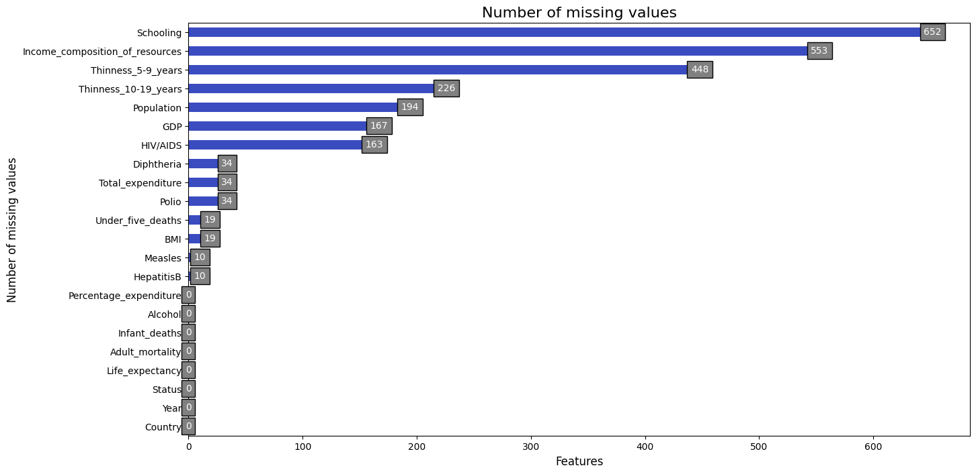
Data
Life Expectancy Dataset (WHO) :
(https://www.kaggle.com/datasets/kumarajarshi/life-expectancy-who/code?datasetId=12603&sortBy=voteCount
Data Set Overview:
Health factors for 193 countries
Data from 2000-2015
22 Columns and 2938 rows
Mainly numeric variables
Null Value imputation strategy:
Median

Slide 5
EDA
Life Expectancy (WHO) (kaggle.com)

Slide 6
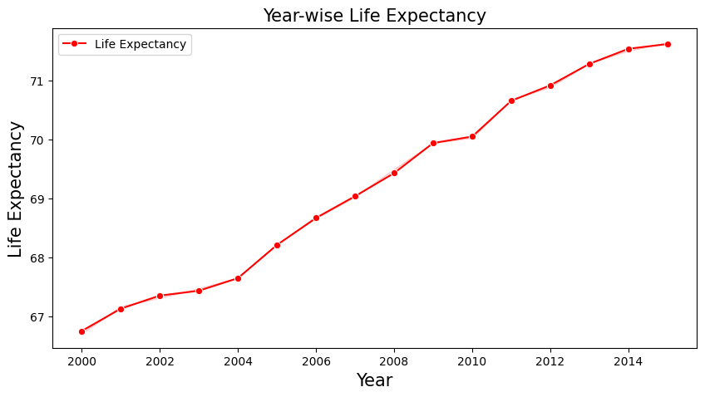
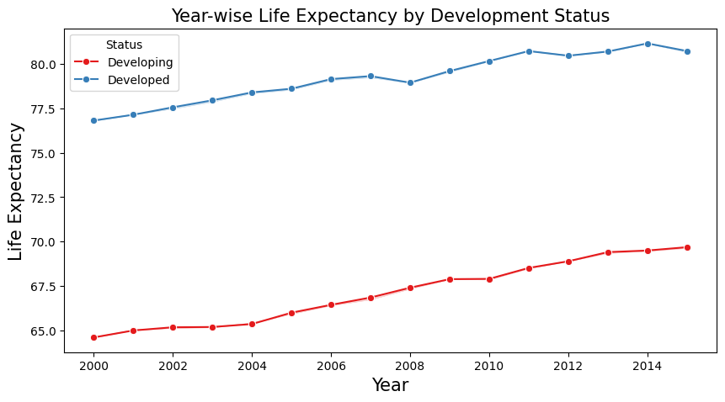
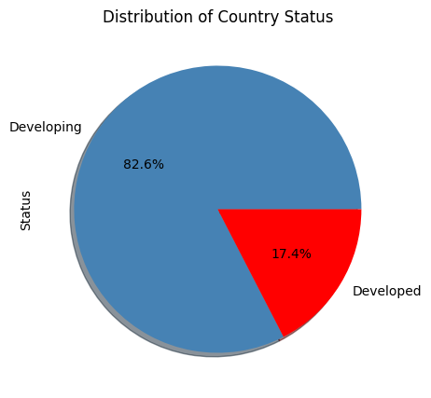
Life Expectancy over the years 2000-2015

Slide 7
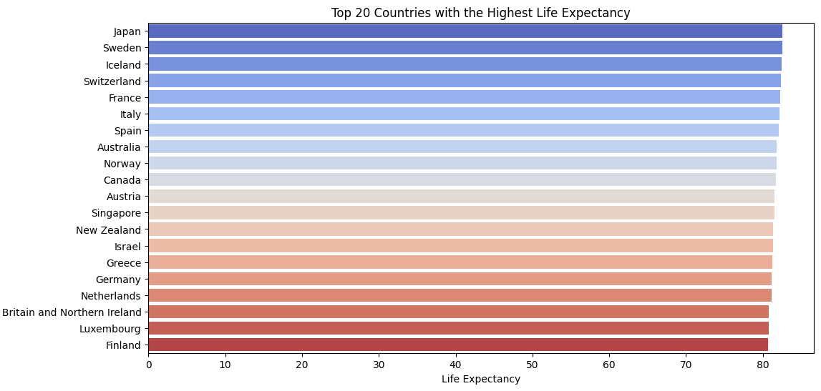
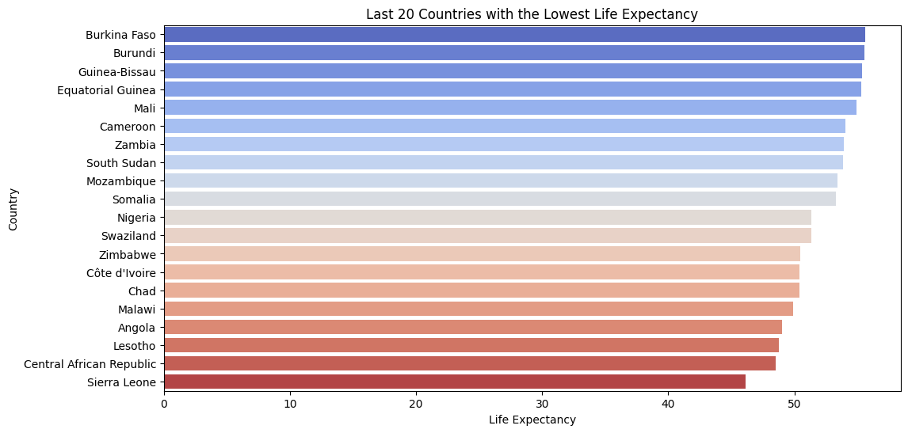
Countries with the Lowest and Highest life expectancies

Slide 8
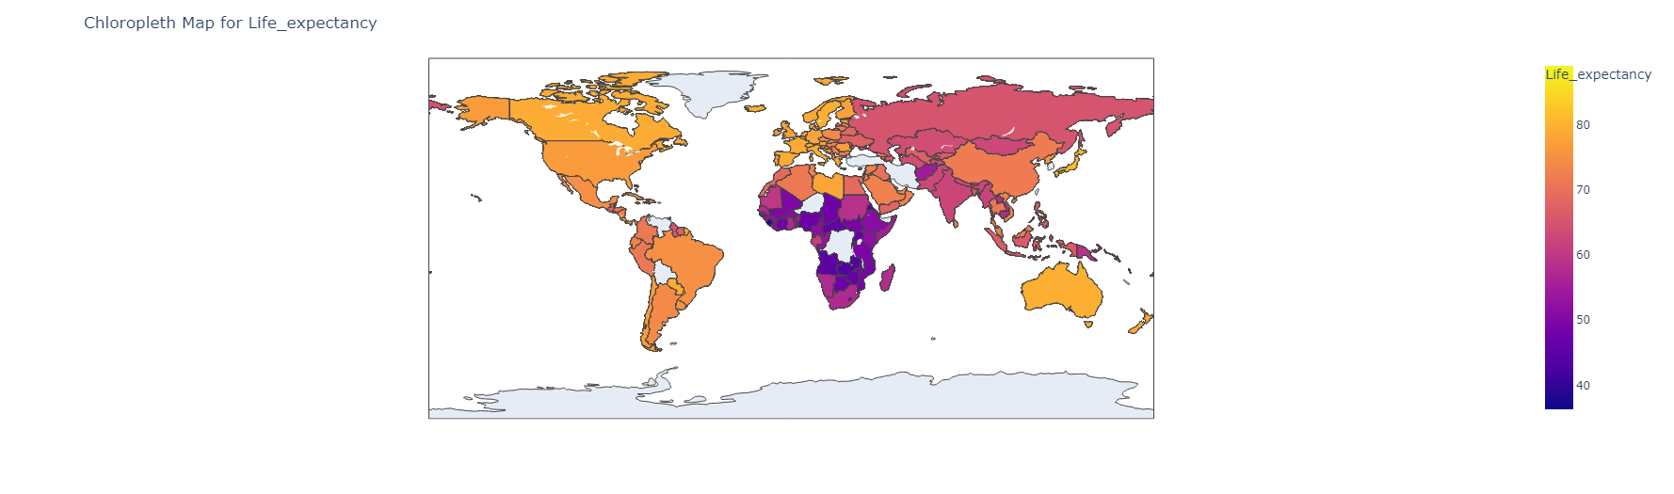
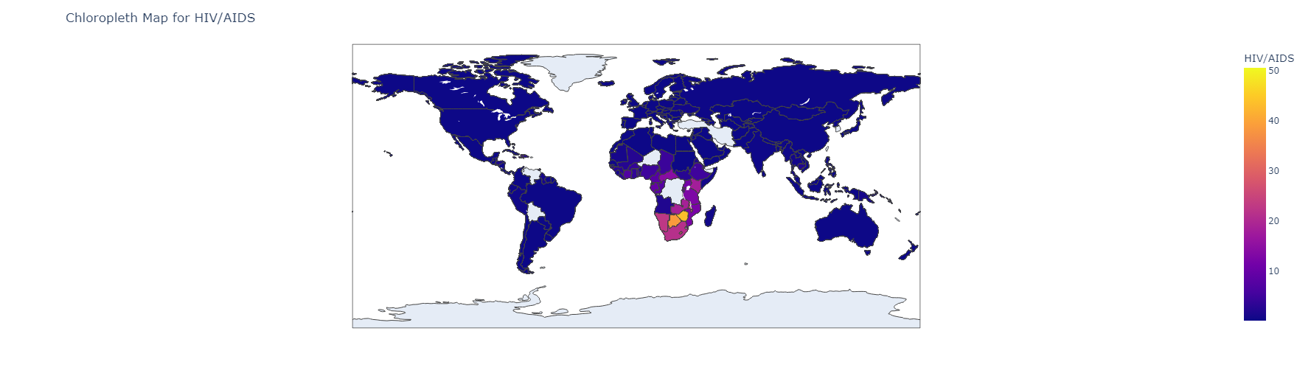
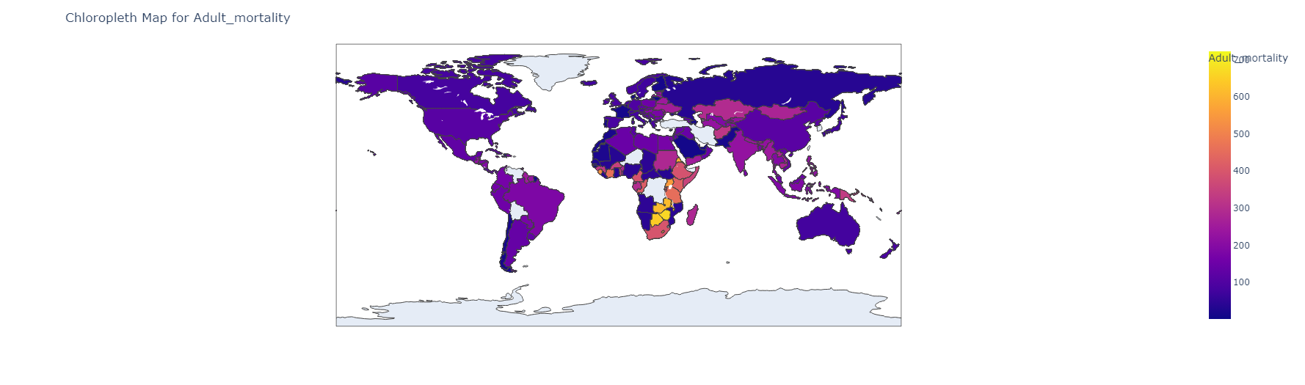
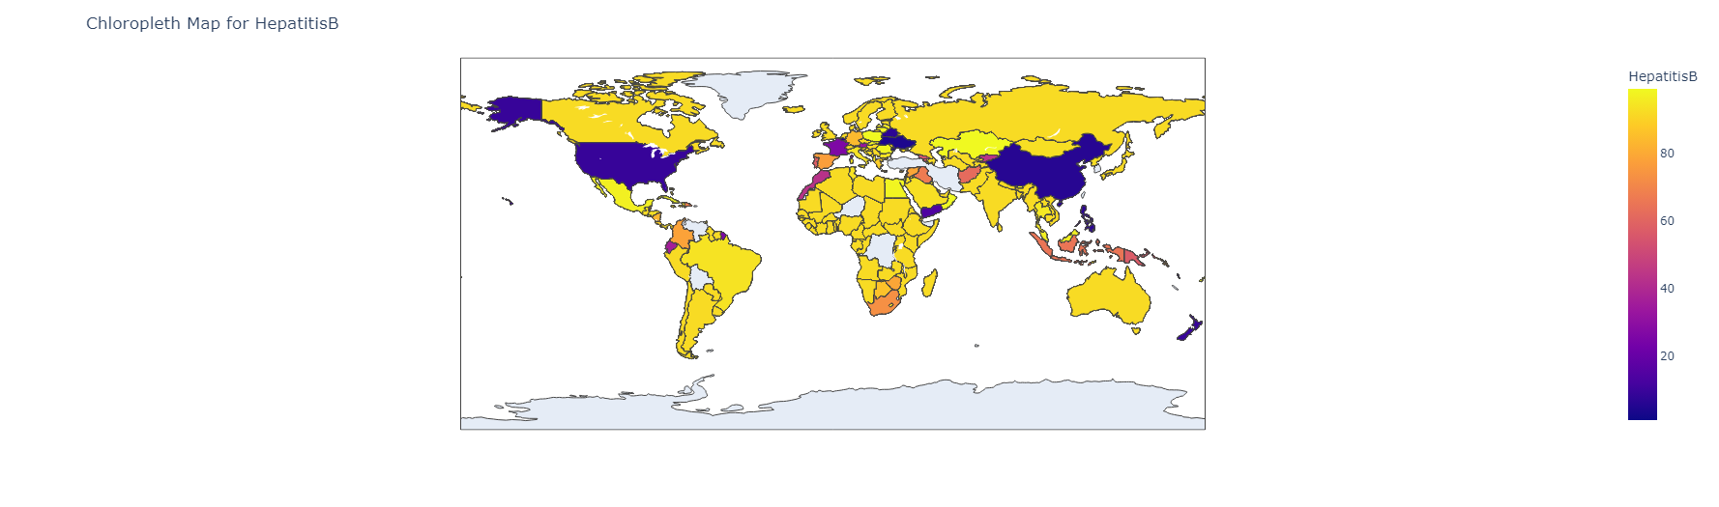
Chloropleth Map Distributions
Life Expectancy
HIV AIDS
Adult Mortality
Hepatitis B

Slide 9
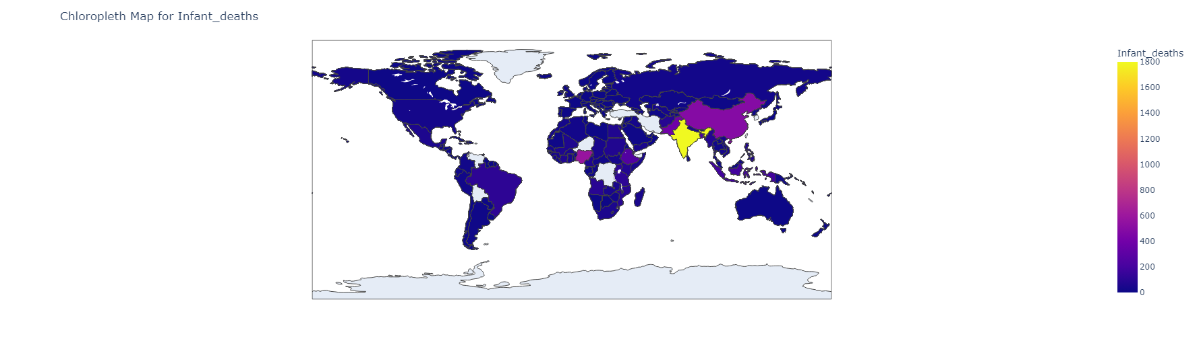
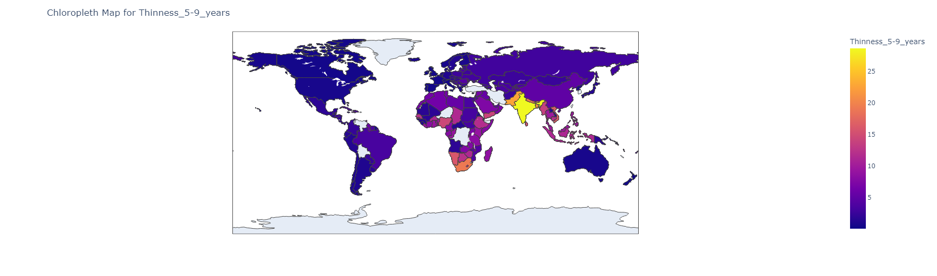
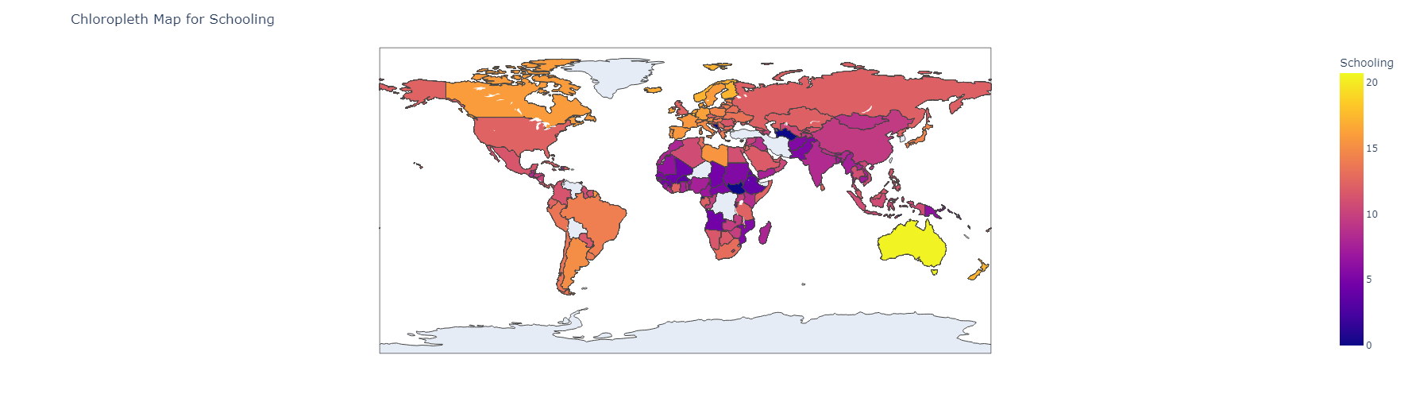
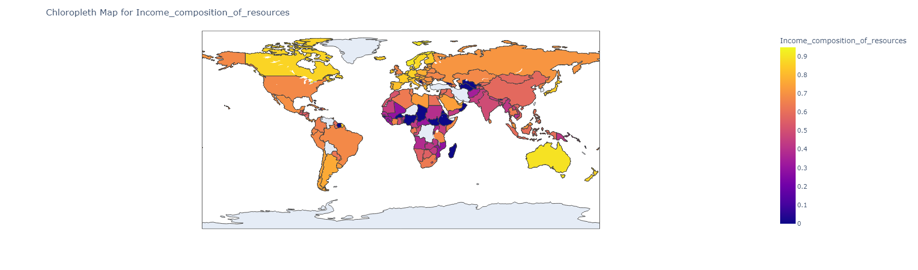
Chloropleth Map Distributions
Infant Deaths
Thinness 5-9 years
Schooling
Income Composition

Slide 10
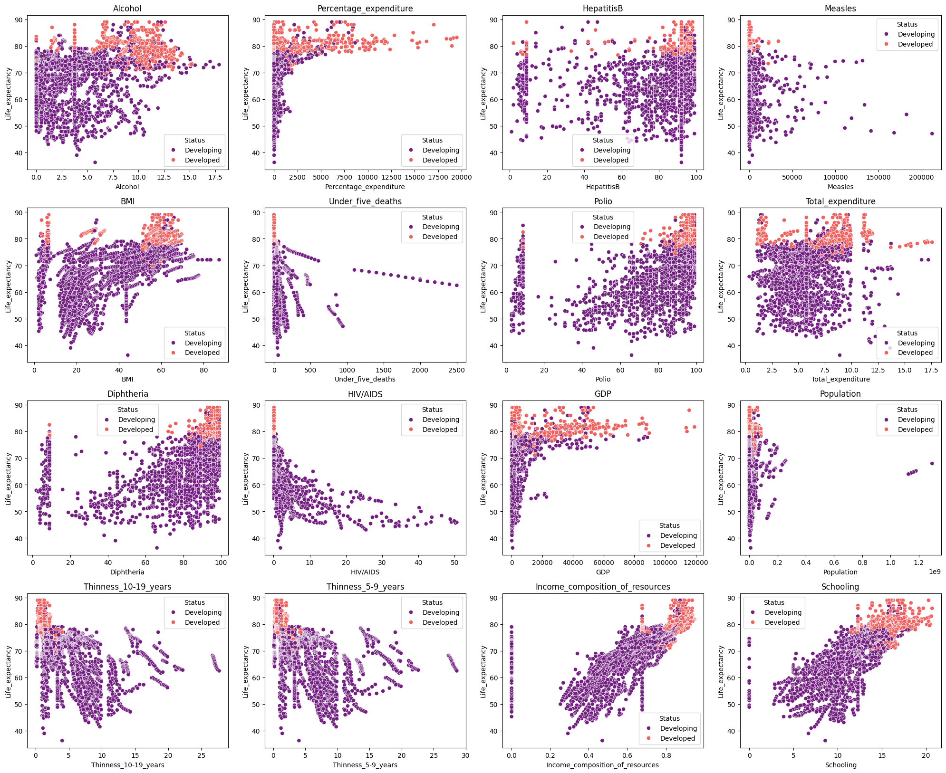
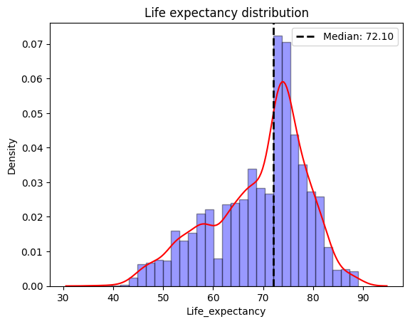
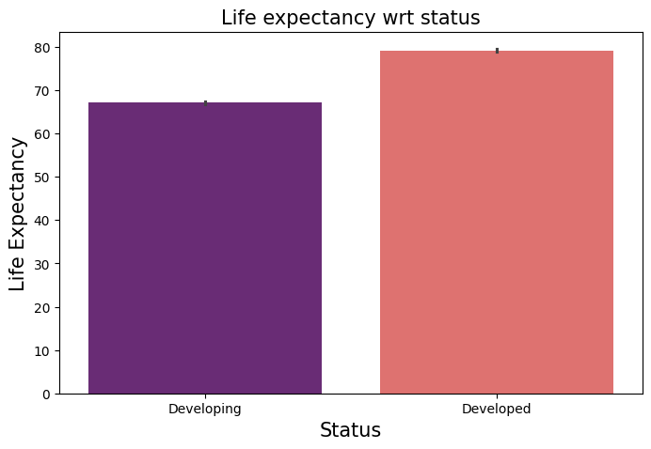
Scatter Plots of features wrt development status
Developed countries display a higher life expectancy for all the features.

Slide 11
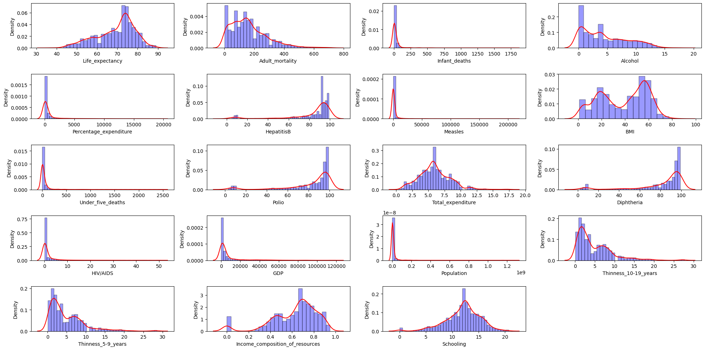
Kernel Density Distribution Plots
The KDE plots of the Features are either right-skewed or Left-skewed and have different scales.

Slide 12
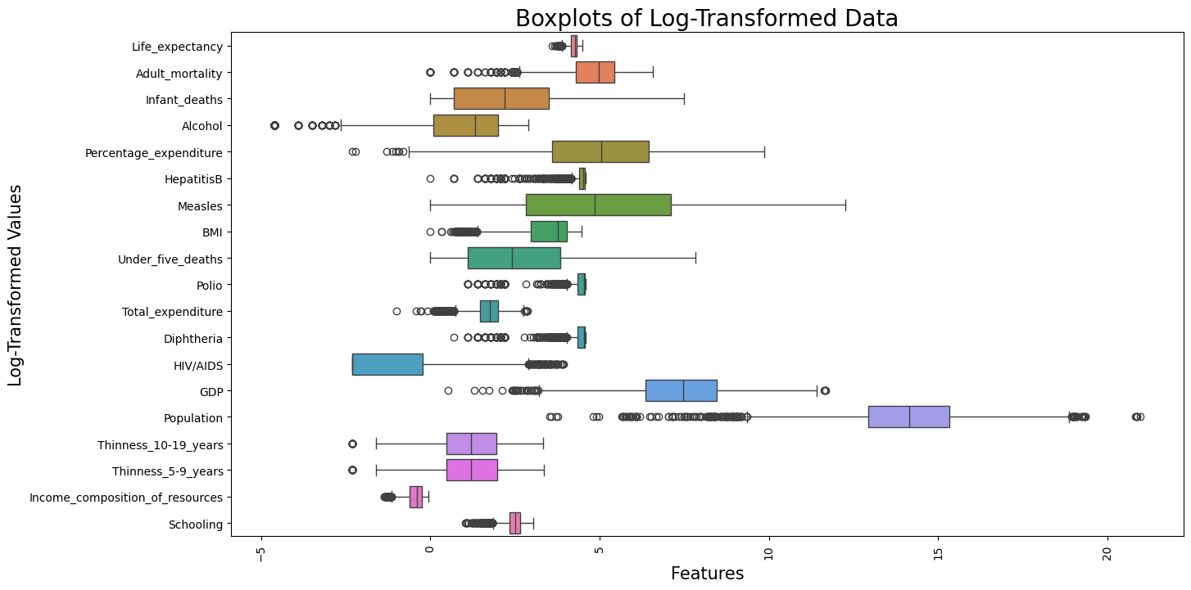
First Log Transformation
All the features have been scaled between the range -5 and 20 after first Log transformation.
Data scaled between -5 and 20

Slide 13
Machine Learning
Life Expectancy (WHO) (kaggle.com)

Slide 14
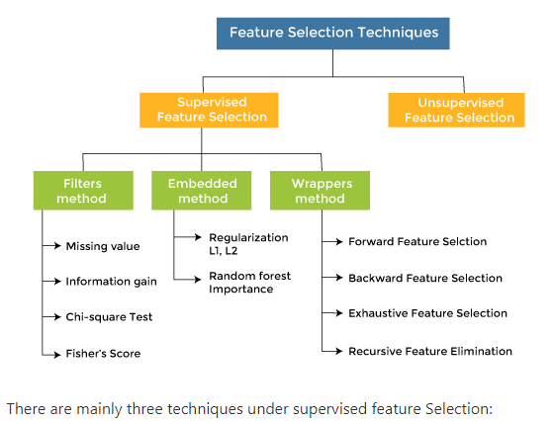
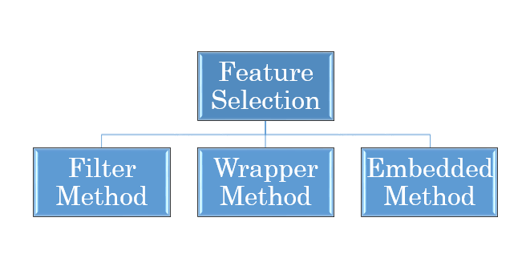
Feature Selection Techniques

Slide 15
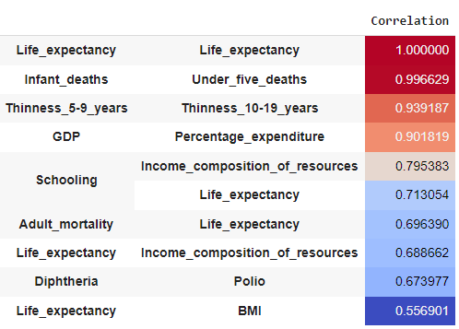
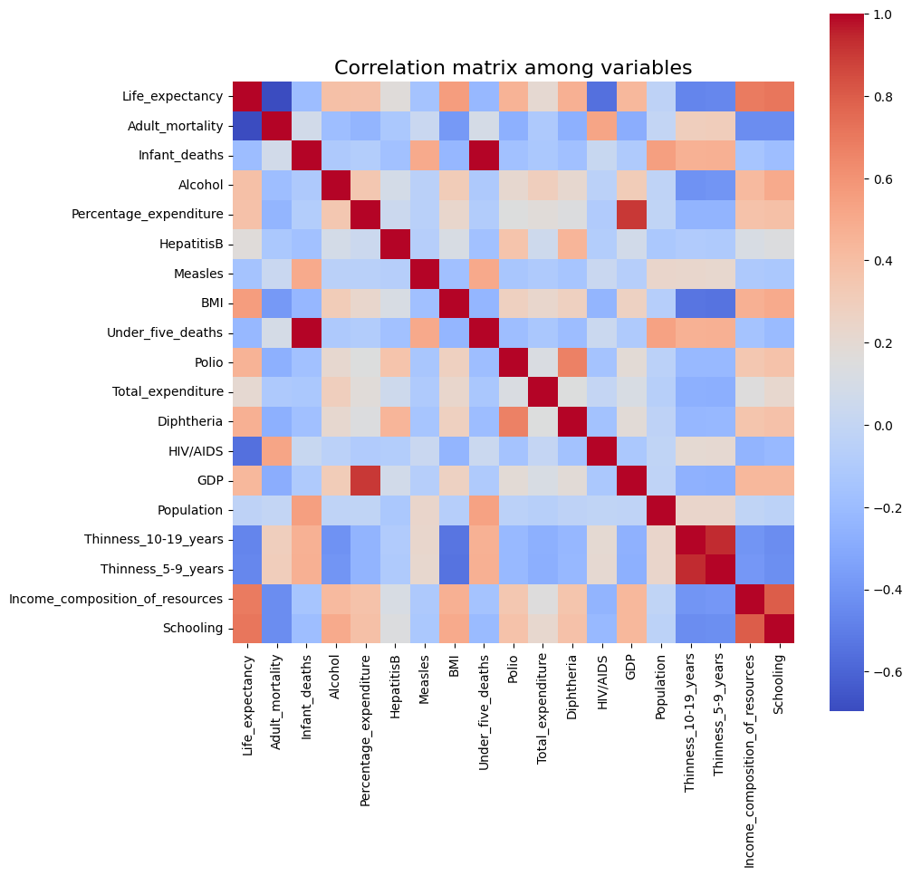
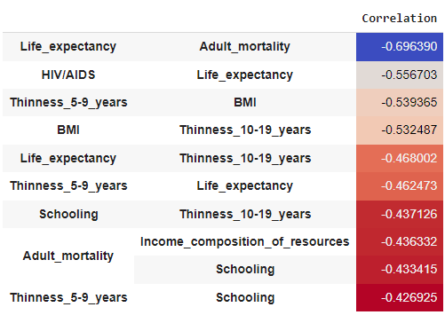
Correlations Heatmap

Slide 16
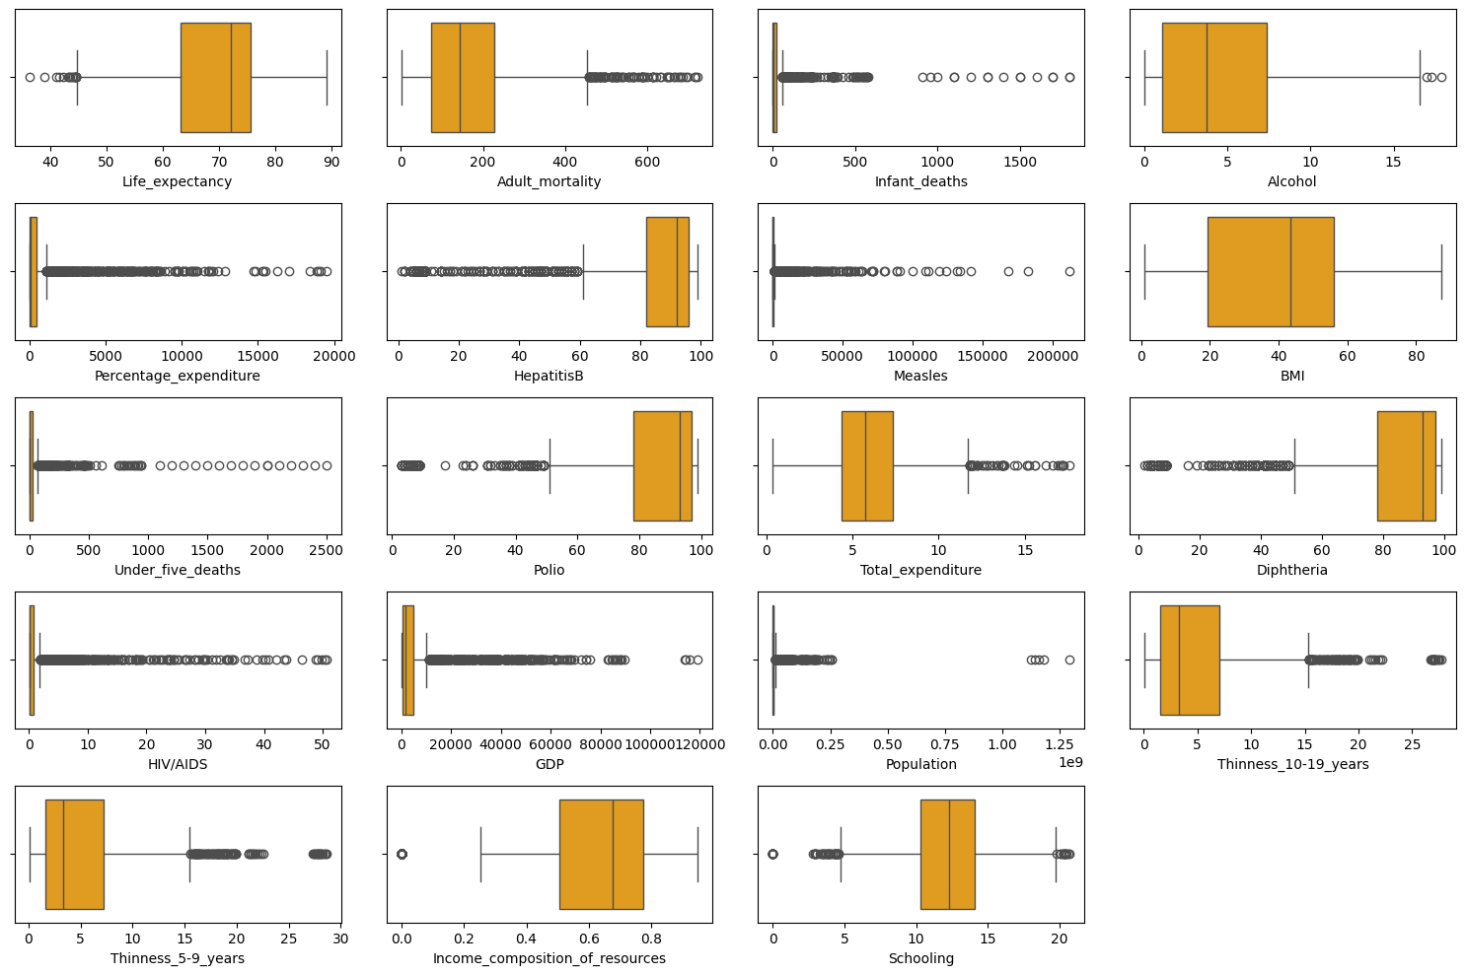
Box Plots for Outlier Visualization
The Box plots for the features show that each of the outliers have a large number of outliers with varying scales.

Slide 17
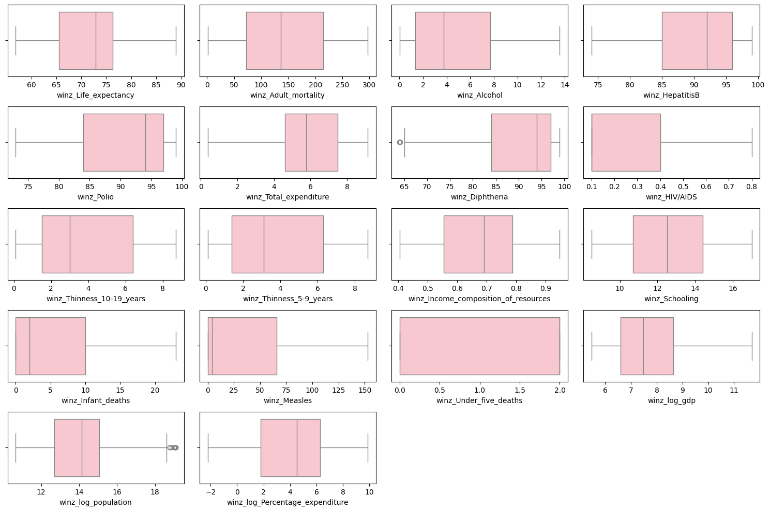
Winsorization method for outlier removal
In winsorization, extreme values are replaced with values closer to the rest of the data.
Points below 5th percentile 🡪 5th Percentile.
Points above 95th percentile 🡪 95th Percentile.

Slide 18



Modeling
DATA SPLITTING
- Training set: 80% - Test set: 20%
MODEL TRAINING
PCA +Linear Regression
Ridge Regression
Lasso Regression
MODEL EVALUATION
R^2, MAE, MSE, RMSE

Slide 19
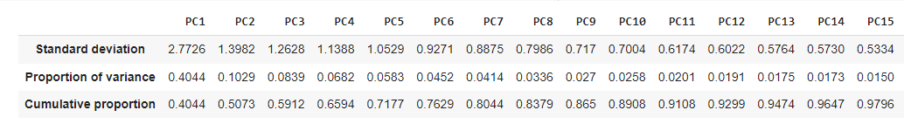
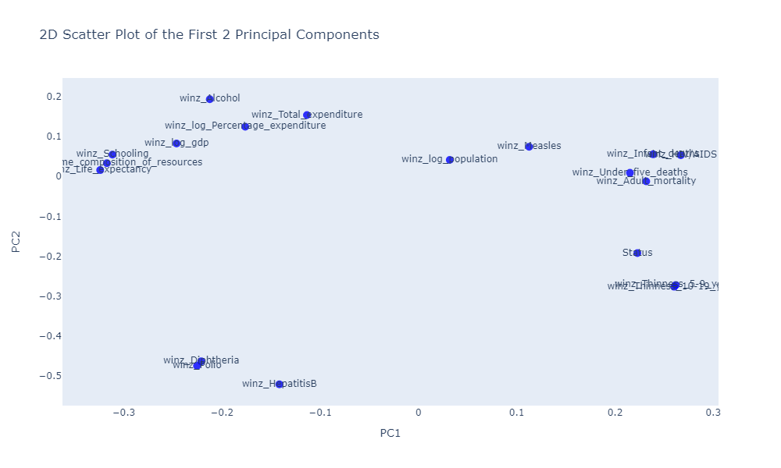
PCA for Dimensionality Reduction
n_components =15
2D Scatter Plot with PC1 and PC2
Proportion of Variance diminishes after PC15. These 15 components explain upto 97% of the total cumulative variance in the data.

Slide 20
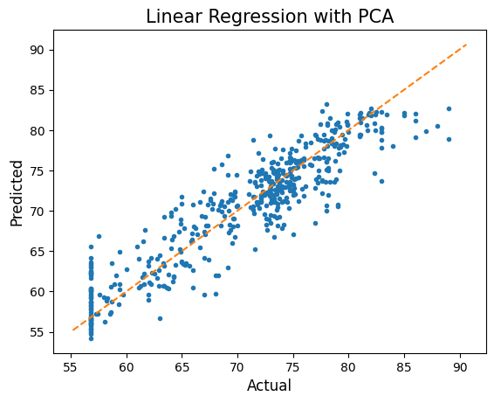
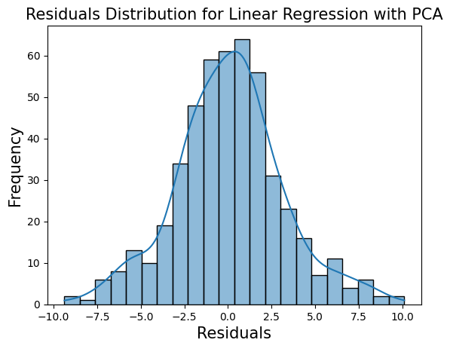
PCA with Linear Regression
R squared = 84.10 %

Slide 21
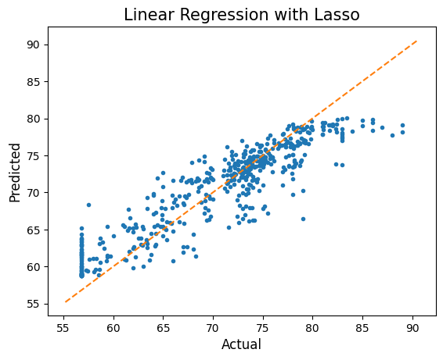
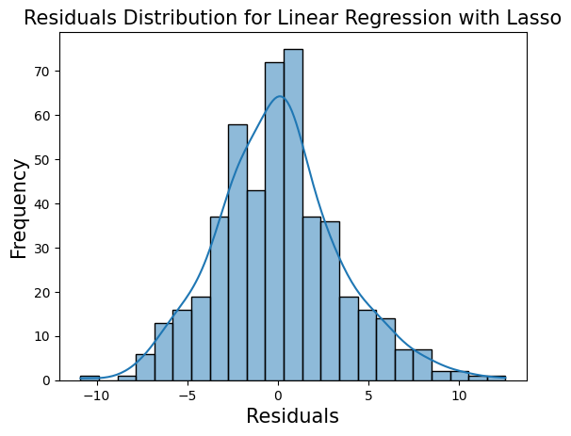
Lasso Regression
R squared = 80.81 %

Slide 22
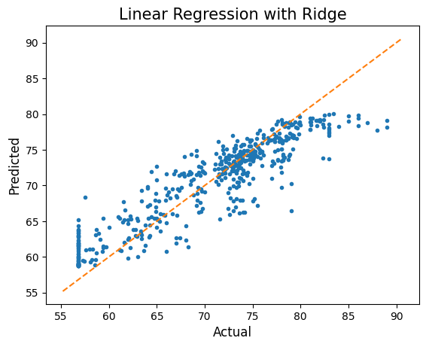
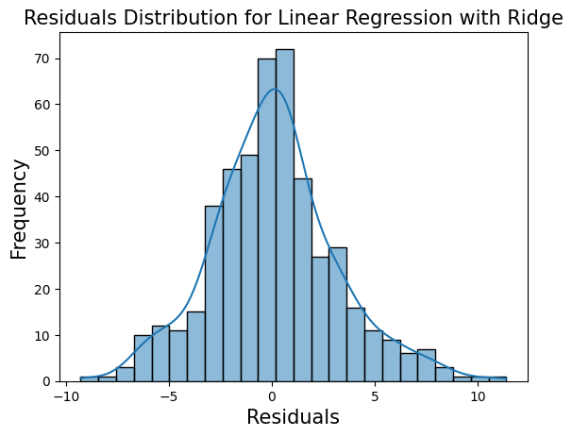
Ridge Regression
R squared = 84.52 %

Slide 23
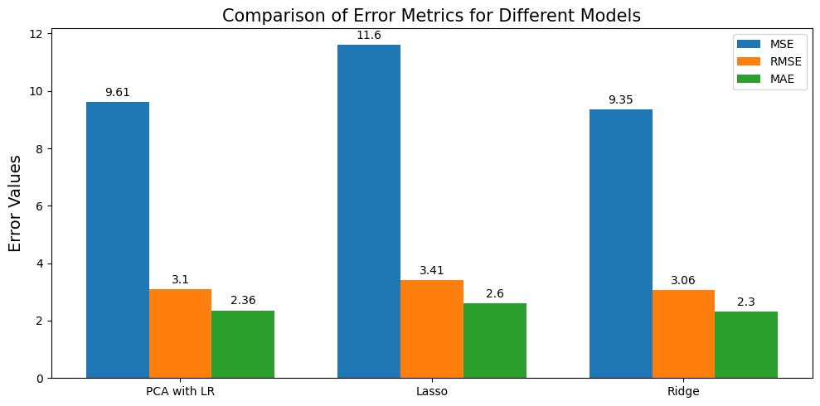
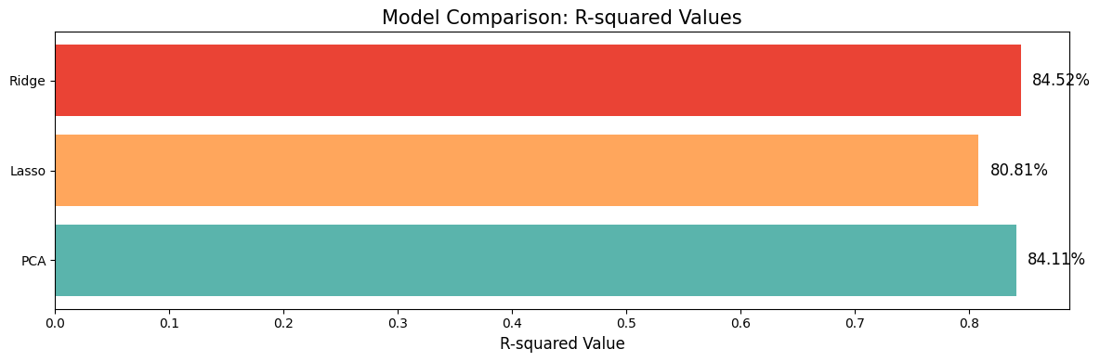
Model Comparison
Best Model -- Ridge Regression R squared = 84.52 %
Ridge regression was able to select the accurate number of features required to explain the variability of the model in contrast to Lasso which reduced most of the variables to zero.

Slide 24
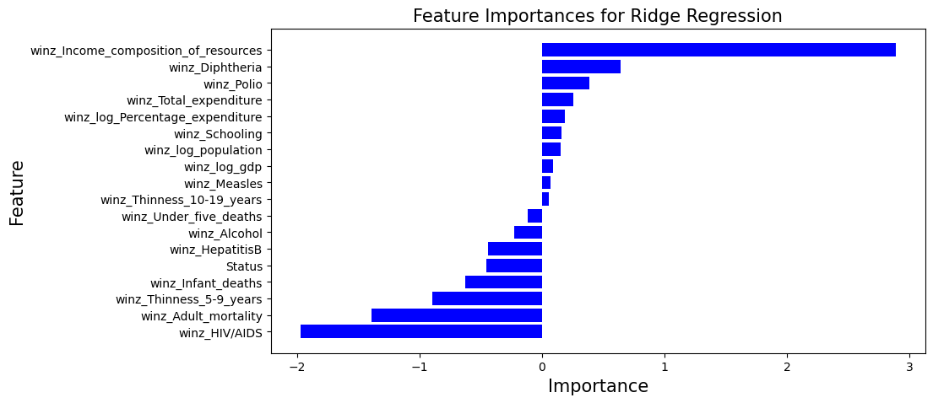
Feature Importances with Ridge Regression
Positive effect on life expectancy
Negative effect on life expectancy

Slide 25
Recommendations and Conclusion
According to the Ridge regression model, the following features have a negative effect on life expectancy. Higher value of these features will result in higher Financial Aid.
HIV AIDS
Adult Mortality
Thinness of Children aged 5-9 years
Infant Deaths
Status of the country -- Developed vs Developing
Hepatitis B
Alcoholism
Under 5 deaths

Slide 26
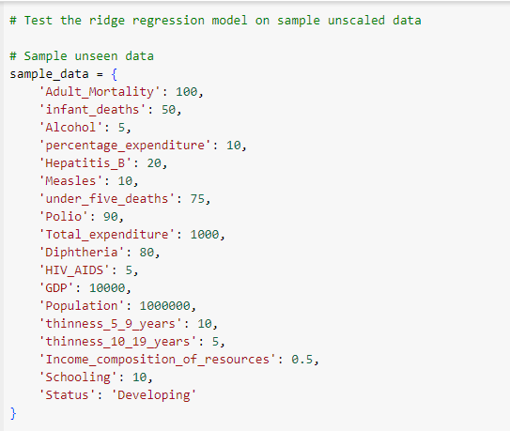
Model Testing on Sample Unseen Data
Financial Aid : Moderate

Slide 27

Questions?

Slide 28

Thank You!

Slide 29
Appendix
Life Expectancy (WHO) (kaggle.com)

Slide 30
